Slide 1
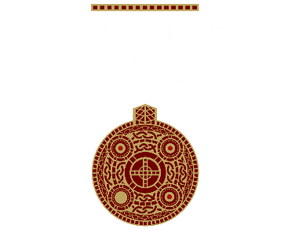

The Winfarthing lady learning resource
Developed by Dale Banham for the Winfarthing Anglo Saxon Project

Slide 2
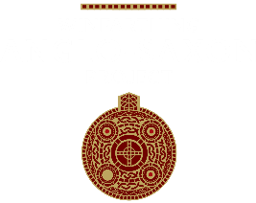
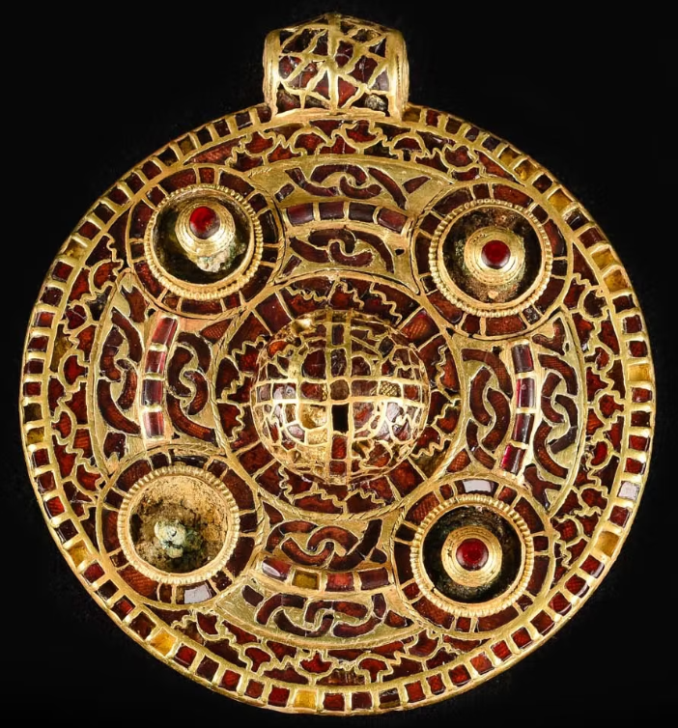
Introduction
This learning resource has been developed with Key Stage 2 pupils in mind, but it could also be used with students of other ages.
This resource has been produced by Dale Banham in partnership with the Winfarthing Anglo-Saxon Project. Dale is an experienced history teacher and an Honorary Fellow of both the Historical Association and the Schools History Project.
We would like to thank the staff and pupils at Bunwell and Banham primary schools for their help in trialling and developing these resources.
Our aims have been to engage pupils with the remarkable Winfarthing archaeological finds and their links to the wider Anglo-Saxon period.
Our resources and activities also shine a light on the roles of historians, archaeologists and museums – building the strong disciplinary knowledge recommended in recent Historical Association and Ofsted reports.
The historical enquiry has been divided into 6 parts. Slides containing notes for teachers contain a black background and can be found at the start of each section.
Image courtesy of Norfolk Museums Service

Slide 3
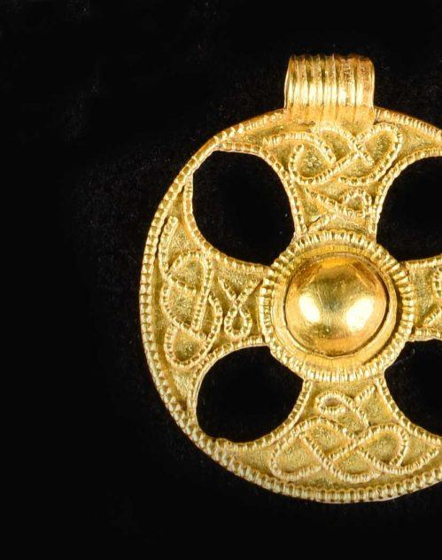
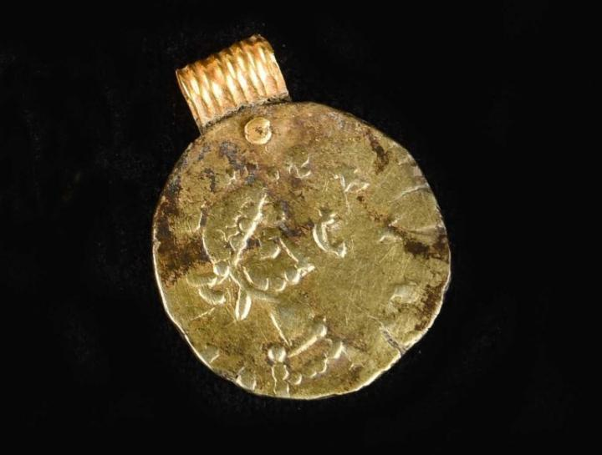
About the Winfarthing Anglo-Saxon Project
The production of this resource has been funded by The National Lottery Heritage Fund as part of Coins and Crosses: Seeking the Anglo-Saxons in Winfarthing and Waveney.
Coins and Crosses is led by The Winfarthing Anglo-Saxon Project, a small committee of local people set up in the wake of the discovery of the Winfarthing treasure in 2015.
For more information on the Winfarthing Anglo-Saxon Project see: https://www.winfarthing-anglosaxon.org/
Images courtesy of Norfolk Museums Service

Slide 4
How to use this resource
During trials of this resource in primary schools we found that dividing pupils into teams and running an ongoing competition worked really well. Teams can be awarded points for correct answers to the quiz questions, chronology challenges, and tasks such as naming as many types of historical source as possible. Bonus points can be awarded for asking good questions and to teams that display good teamwork (e.g. everyone in the team contributing, good listening skills, etc). The loss of points can also be used to keep pupils on task and focused (e.g. if pupils talk whilst other pupils are talking, or if they are off task during team discussions). We also found that awarding bonus questions for appropriate historical language encouraged pupils to use the key phrases on the degree of certainty line more frequently (see Part 3: How was the Winfarthing burial revealed?).

Slide 5
Contents
Part 1: What is the difference between a historian and an archaeologist?
Part 2: What do you already know about the Anglo-Saxons?
Part 3: How was the Winfarthing burial revealed?
Part 4: What do the clues found by Time Team reveal about the person who was buried in the grave and why she was buried there?
Part 5: What was life like in a typical Anglo-Saxon village?
Part 6: What have you learnt about the Anglo-Saxons?

Slide 6
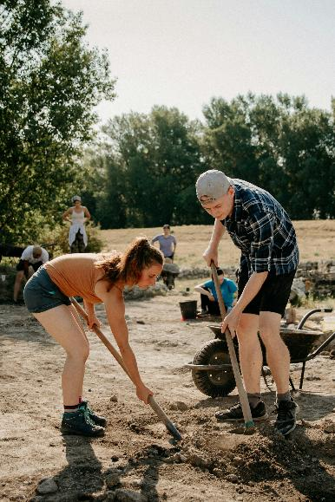
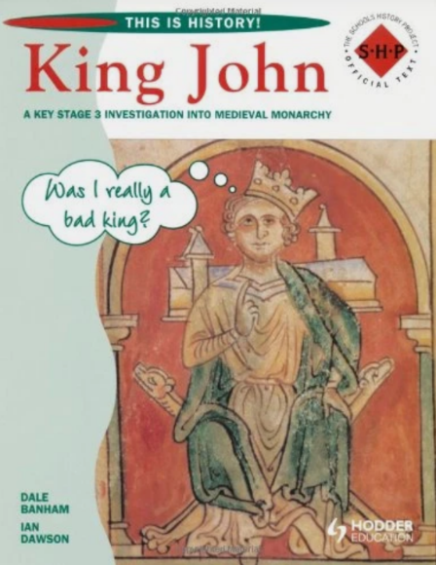
PART 1
Introduction: What is the difference between a historian and an archaeologist?
Notes for teachers
This introduction helps to build on pupils’ understanding of the roles of archaeologists and historians.
Understanding how historians work and the relationship between history and archaeology is an important part of building strong disciplinary knowledge (see Ofsted report, 2023).
Disciplinary knowledge is knowledge of how historians investigate the past, and how they construct historical claims, arguments and accounts.
Pupils make progress in history through building their knowledge of the past, and of how historians study the past and construct accounts.
Notes:
Photo by Trnava University on Unsplash

Slide 7
Task 1 – historian or archaeologist?
Notes for teachers
The task on the following slides ask pupils to think about whether particular statements or photographs are more likely to represent historians or archaeologists.
You could print these slides for pupils to make notes on (without the answers!), or have pupils put up their hands to answer or vote on what they think the answer is.
As you forward the slides the answers will appear.

Slide 8

Task: Historians or Archaeologists?
Look at the statements and pictures below.
- Put an H next to the statements that are linked to what historians do
- Put an A next to statements that are linked to what archaeologists do
To print
1 | Excavate historical sites and identify and classify what they find.
2 | Ask questions about the past and use a range of sources from the past to try and answer those questions.
3 | Use archives containing written and visual sources to find out about the past.
4 | Look for clues to understand our past. They do this by looking at the landscape or studying objects found on digs.

Slide 9
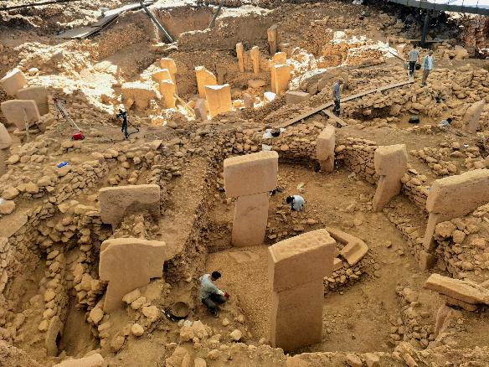
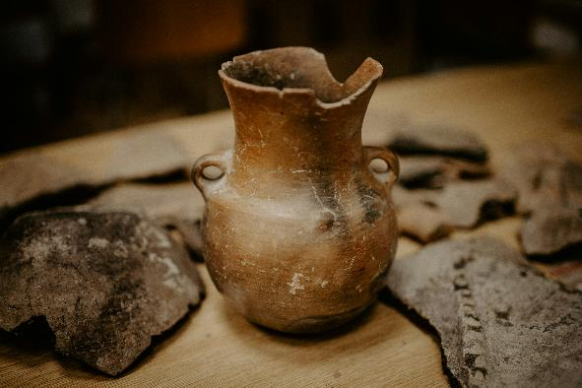
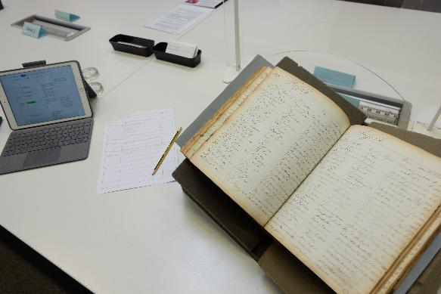
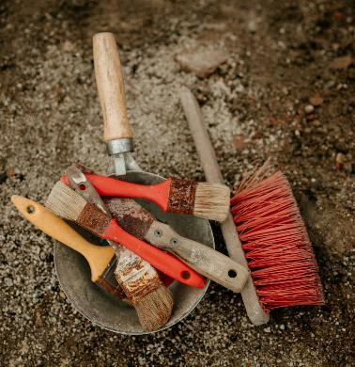
Task: Historians or Archaeologists?
To print
5
6
7
8
Notes:
5 Photo by Alper Murat KİRPİK on Pexels https://www.pexels.com/photo/an-ancient-stone-structure-is-being-excavated-in-the-desert-27946497/
6 Photo by Trnava University on Unsplash
7 Photo by Hannah Salisbury
8 Photo by Trnava University on Unsplash

Slide 10
Task: Historians or Archaeologists?
Look at the statements and pictures below.
- Put an H next to the statements that are linked to what historians do
- Put an A next to statements that are linked to what archaeologists do
1 | Excavate historical sites and identify and classify what they find.
2 | Ask questions about the past and use a range of sources from the past to try and answer those questions.
3 | Use archives containing written and visual sources to find out about the past.
4 | Look for clues to understand our past. They do this by looking at the landscape or studying objects found on digs.
Archaeologist
Historian
Historian
Archaeologist

Slide 11
Task: Historians or Archaeologists?
5
6
Archaeologist
Archaeologist
7
8
Historian
Archaeologist
Notes:
5 Photo by Alper Murat KİRPİK on Pexels https://www.pexels.com/photo/an-ancient-stone-structure-is-being-excavated-in-the-desert-27946497/
6 Photo by Trnava University on Unsplash
7 Photo by Hannah Salisbury
8 Photo by Trnava University on Unsplash

Slide 12
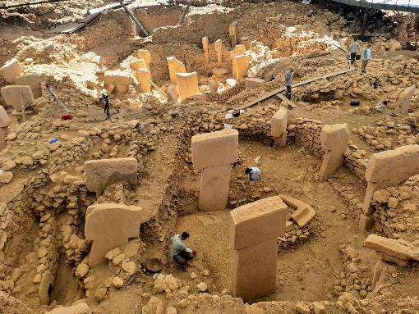
Archaeologists or Historians?
ARCHAEOLOGISTS
Excavate historical sites
Identify and classify what they find
Preserve or record their finds
Archaeologists are like detectives. They look for clues to understand our past. They do this by excavating under the ground or looking at the landscape or studying objects found on digs.
They know a lot of history (to provide context) for what they discover.
HISTORIANS
Ask questions about the past
Use a range of sources from the past to try and answer those questions
Use other historians’ interpretations
Produce interpretations – this means making their own historical claims
These claims are checked by other historians
They can argue with other historians

Slide 13
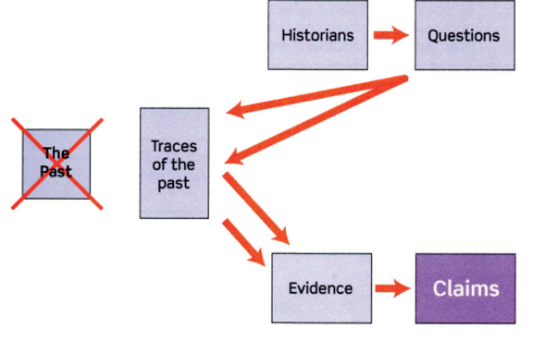
What do historians do?
Historians ask questions about the past.
Since they can’t actually time travel and visit the past, they use traces of the past (sources) to try and answer these.
They uses these sources as evidence to support claims they make about the past.
The claims they make about the past are sometimes published in a history book or an article.
The work that they produce is called an interpretation.
Interpretations of the past produced by historians could also include documentary films or podcasts.
Notes:
Diagram by Ian Dawson https://thinkinghistory.co.uk/index.html

Slide 14
TEAM CHALLENGE: What sources can a historian use to find about the past?
How many different types of source can you name?
For example: newspaper
Diary
Video recordings
Photographs
Letters
Eyewitness accounts
Sound recordings
Buildings
Maps

Slide 15
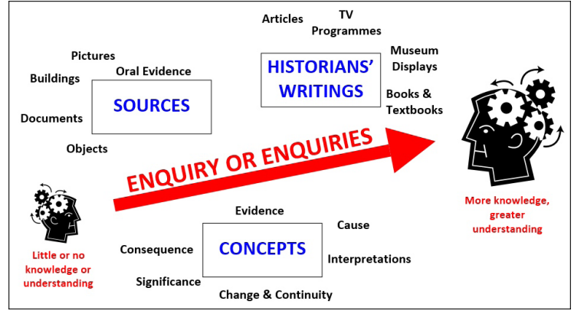
How do historians find out about the past?
Remember – the work they produce is called an interpretation.
They support this interpretation with evidence – they are not allowed to make things up!
They explore what changed and what stayed the same (change & continuity).
Historians argue about which events or people are the most significant.
As well as using sources (such as those in the diagram) they can also use the work of other historians.
Historians are interested in the causes and consequences of events in the past.
When Historians try and answer questions about the past it is called an Enquiry.
As they work on their enquiry, they build more knowledge and understanding about the past.
Notes:
Diagram by Ian Dawson https://thinkinghistory.co.uk/index.html

Slide 16
PART 2: What do you already know about the Anglo-Saxons?
Notes for teachers
Part 2 builds on pupils’ understanding of the Anglo-Saxon period. It starts by placing the Anglo-Saxon period in a chronological framework. It is important to do this at the start of teaching a new historical enquiry.
The human timeline activity (see opposite) can really help pupils grasp the chronological order and time span of each period.
The second activity asks pupils to use a word wall to describe the Anglo-Saxon period. We return to this at the end of the historical enquiry (see PART 6) to see if the Winfarthing find has change their perceptions of the Anglo-Saxons.
Part 2 also asks the key question ‘How do we know about this period?’ and explores the evidence base for historical interpretations about the Anglo-Saxon period. This early part of this period is characterised by limited written evidence which makes archaeology a key part of finding out about the early Anglo-Saxons.

Slide 17
Activities – when where they around?
Notes for teachers
It is important when teaching historical enquiries to locate them within a chronological framework. The next activities are designed to do that for the Anglo-Saxon period so pupils get an understanding of what came before and after this period, and how long each period was.
Task A: Before or after – this slide lists a selection of time periods. Ask the students if they think each period is before or after the Anglo-Saxons. A printable version of the slide is provided. On the answer slide the answers are revealed as you move on.
Task B: Putting periods in chronological order – this slide lists a selection of time periods. As you move the slide on the time periods will slot into place on the timeline. How many can the students get right?
Task C: Human timeline – each child represents 100 years. Ask for volunteers to stand in a line to represent the different eras between us and the Anglo-Saxons. Are they surprised how many people they need to get there? Are they surprised how many/few people represent each era? The slide for this provides clues to help, and the answers will be revealed as you move the slides on.

Slide 18
What do you already know about the Anglo-Saxons?
To print
When were they around?
TASK A: Before or after competition – in your teams, decide if you think the Anglo-Saxons came before or after these other time periods/events.
The Romans | The Normans
The Victorians | The Ancient Greeks
The Ancient Egyptians | The Second World War
The Tudors | The Bronze Age
The Stone Age | England winning the World Cup

Slide 19
What do you already know about the Anglo-Saxons?
When were they around?
TASK A: Before or after competition – in your teams, decide if you think the Anglo-Saxons came before or after these other time periods/events.
The Romans | The Normans
The Victorians | The Ancient Greeks
The Ancient Egyptians | The Second World War
The Tudors | The Bronze Age
The Stone Age | England winning the World Cup
Before
After
After
Before
Before
After
After
Before
Before
After

Slide 20
TASK B: In your teams, can you put the time periods in chronological order?
The Romans in Britain
The Victorians
The Ancient Egyptians
The Tudors
The Stone Age
The Normans
The Ancient Greeks
The Second World War
The Bronze Age
England winning the World Cup
3150 BCE - 30 BCE
1837-1901
1966
800 BCE – 146 BCE
1066-1154
c.3.3 million years ago – c.2000 BCE
2500 BCE – 800 BCE
43-410
1485-1603
1939-1945

Slide 21
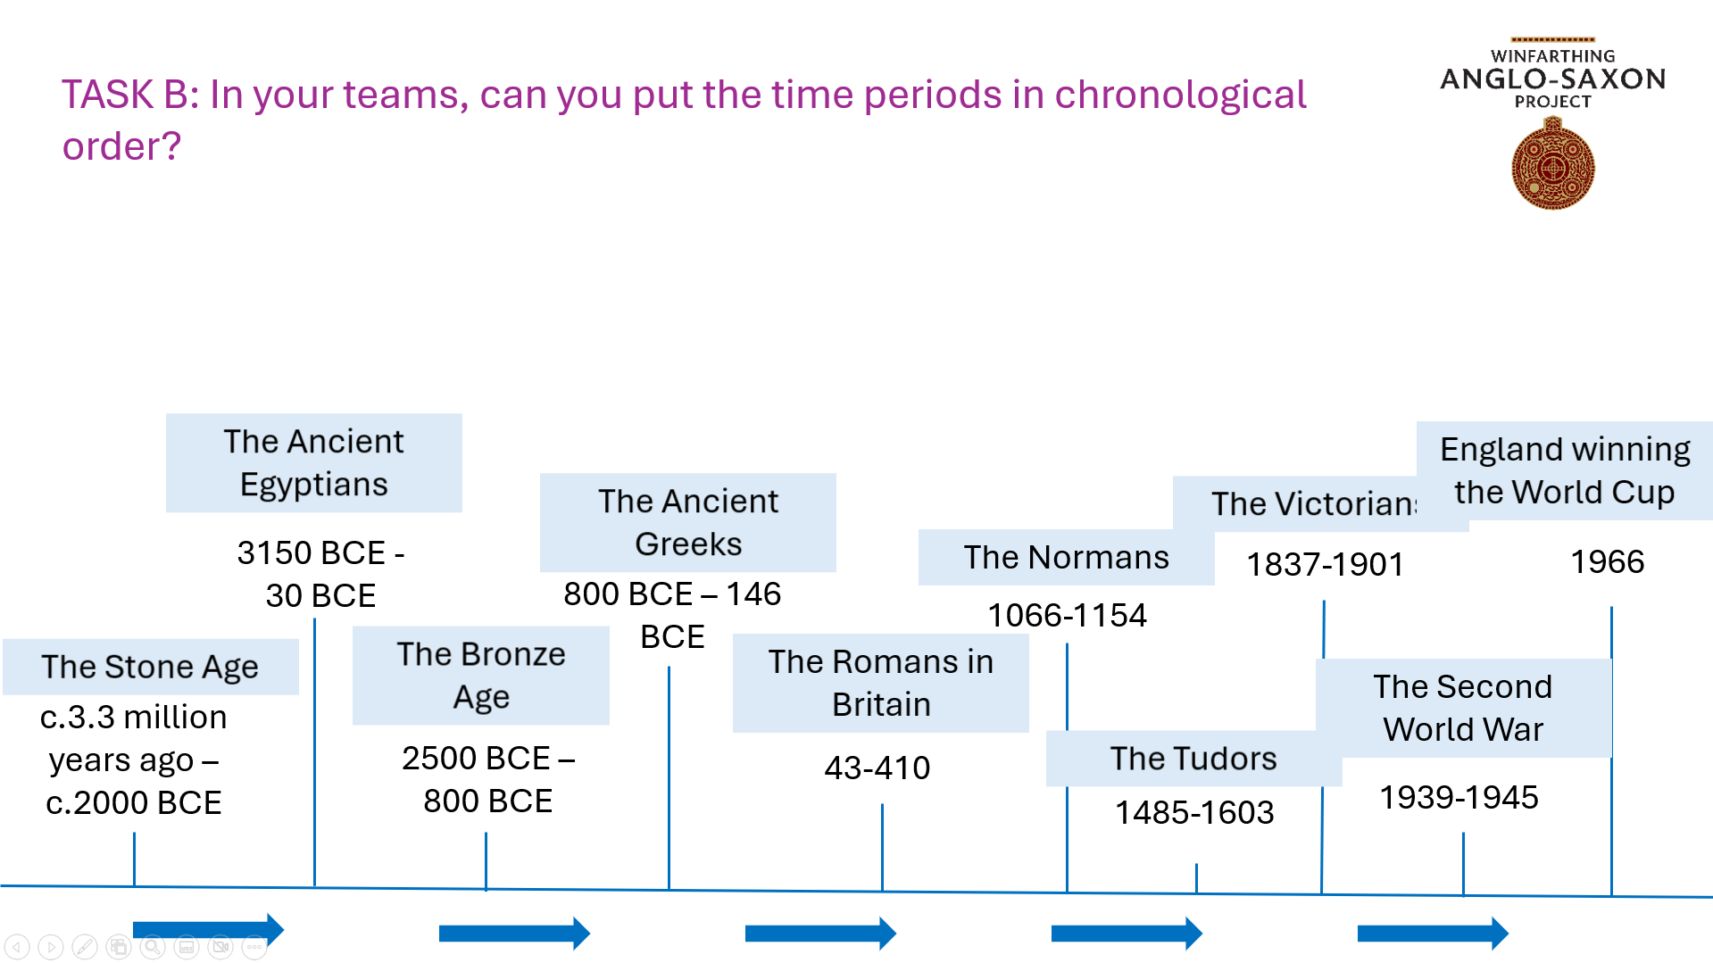
The Anglo-Saxons
410-1066
Where do the Anglo-Saxons go on this timeline?

Slide 22
TASK C: WHOLE CLASS CHALLENGE
Form a human timeline showing how long each time period lasted for!
If each person represents 100 years, how many people would you need in your timeline to get from the present day back to the Anglo-Saxon period?
Use the clues on the next slide to help you.

Slide 23
If each person represents 100 years, how many people would you need in your timeline to get from the present day back to the Anglo-Saxon period?
Stuart Era
1603-1714
Victorian Era
1837-1901
21st C
2000-2026
Anglo-Saxons
410-1066
Norman Era
1066-1154
Medieval Era
1155-1485
Tudor Era
1485-1603
Georgian Era
1714-1837
20th C
1901-2000
88 yrs
3 centuries and a bit
1 century and a bit
1 century and a bit
1 century and a bit
73 yrs
1 century
6 centuries and a bit
26 years

Slide 24
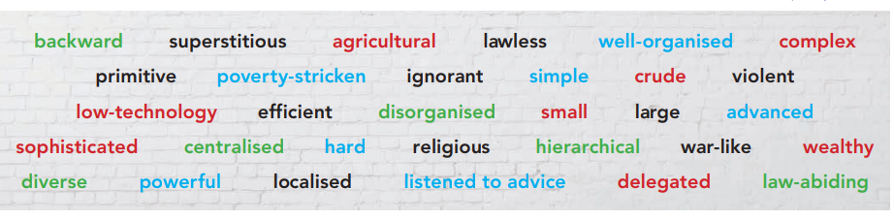
What do you already know about the Anglo-Saxons?
What three words would you use to describe the Anglo-Saxons? You can use the ones below for ideas.

Slide 25
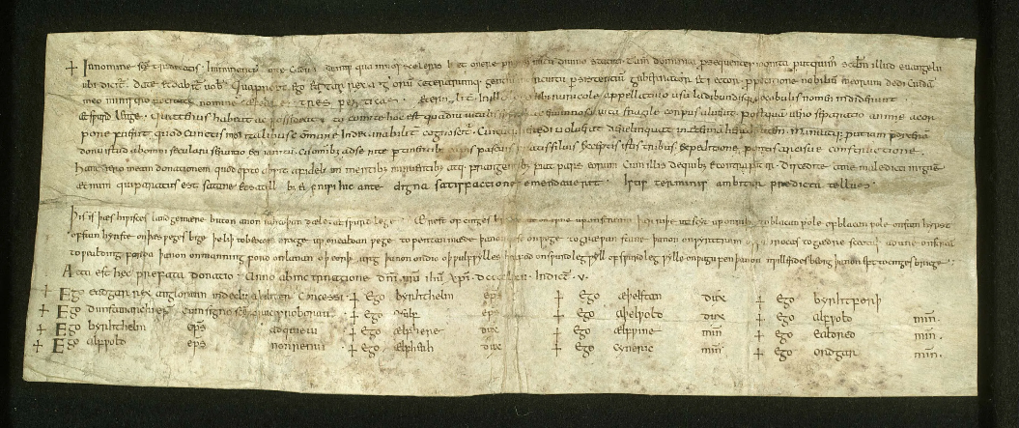
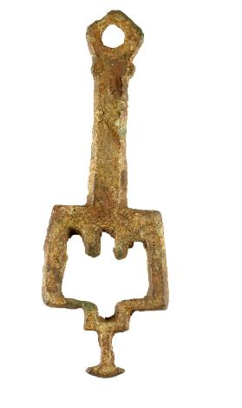
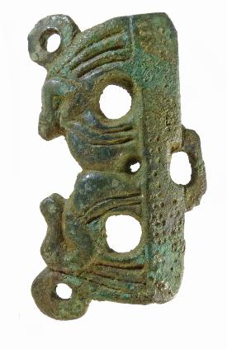
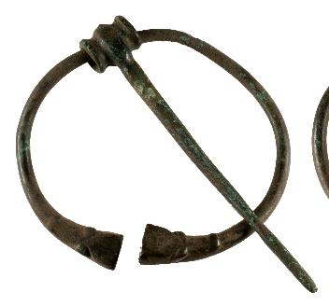
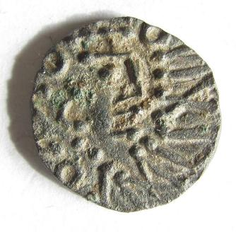
What do you already know about the Anglo-Saxons?
2. How can we find out about the early Anglo-Saxons?
Archives? (written records)
Artefacts? (objects)
TASK: What questions can you ask about a source?
How many questions can you think of?
Notes:
Document: Anglo-Saxon Charter, Essex Record Office, D/DP T209, https://www.essexrecordofficeblog.co.uk/the-beginning-our-oldest-document/
Artefacts, clockwise from top left:
Booth, A. (2026) SF-2A545E: Medieval key (locking). Web page available at https://finds.org.uk/pas/recorded-find/SF-2A545E under a CC-BY licence [Accessed: 10 Aug 2026 10:28:45]
Rogerson, A. and Hines, J. (2017) NMS-380C00: Early Medieval sleeve clasp. Web page available at https://finds.org.uk/pas/recorded-find/NMS-380C00 under a CC-BY licence [Accessed: 10 Aug 2026 10:29:16]
Booth, A. (2026) SF-0EB743: Early Medieval brooch. Web page available at https://finds.org.uk/pas/recorded-find/SF-0EB743 under a CC-BY licence [Accessed: 10 Aug 2026 10:30:43]
Marsden, A. (2012) NMS-2DB7E8: Early Medieval coin. Web page available at https://finds.org.uk/pas/recorded-find/NMS-2DB7E8 under a CC-BY licence [Accessed: 10 Aug 2026 10:31:33]

Slide 26
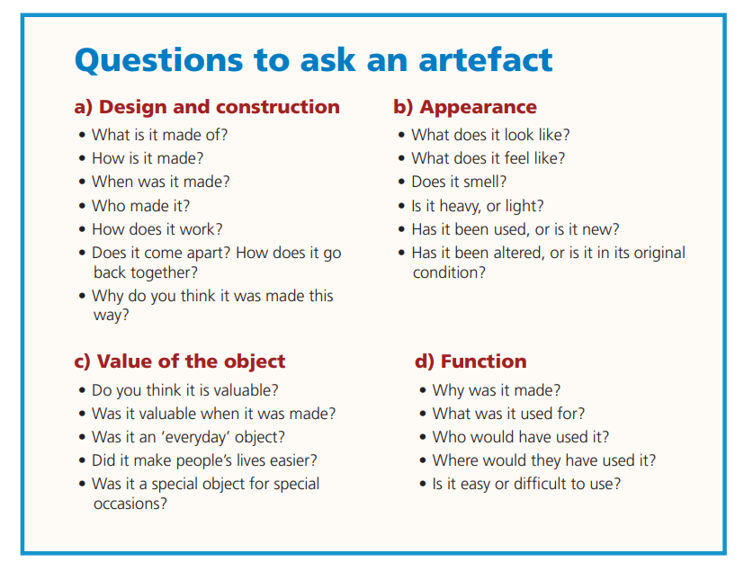
What questions can you ask about a source?
HISTORIANS USE THE 5Ws
What? What type of source is it?
Document or artefact?
When? When was it produced?
Where? Where was it produced?
Where was it found?
Who? Who produced it?
Who did it belong to?
Why? Why was it produced?
Why is it useful to a historian? Why is it significant?
Notes:
Questions to ask an artefact by Ian Dawson https://thinkinghistory.co.uk/index.html

Slide 27

PART 3: How was the Winfarthing burial revealed?
Notes for teachers
Part 3 starts with a gradual reveal of the incredible jewellery that was found at Winfarthing. At each stage of the reveal ask pupils to develop a hypothesis. What do they think that the mystery object is that has been found?
It is important to develop pupils’ use of historical language here. Reward the use of historical language that reflects how certain the historian is when they develop an initial hypotheses or makes a claim about the past.
At an early stage of the enquiry process, historians are rarely ‘totally sure’ about their findings, they use tentative language to express this (such as ‘possibly’ or ‘perhaps’.
As pupils state their hypothesis get them to out of their seats and stand on the DEGREE OF CERTAINTY LINE (see below) to reflect their position.
The final activity gets pupils to think about the historical process and sets them the challenge of sequencing the journey from the first discovery at Winfarthing through to the pendant being preserved and displayed in a national exhibition and later at Norwich Castle Museum. The slides for this will need to be printed out and jumbled up for this challenge.

Slide 28

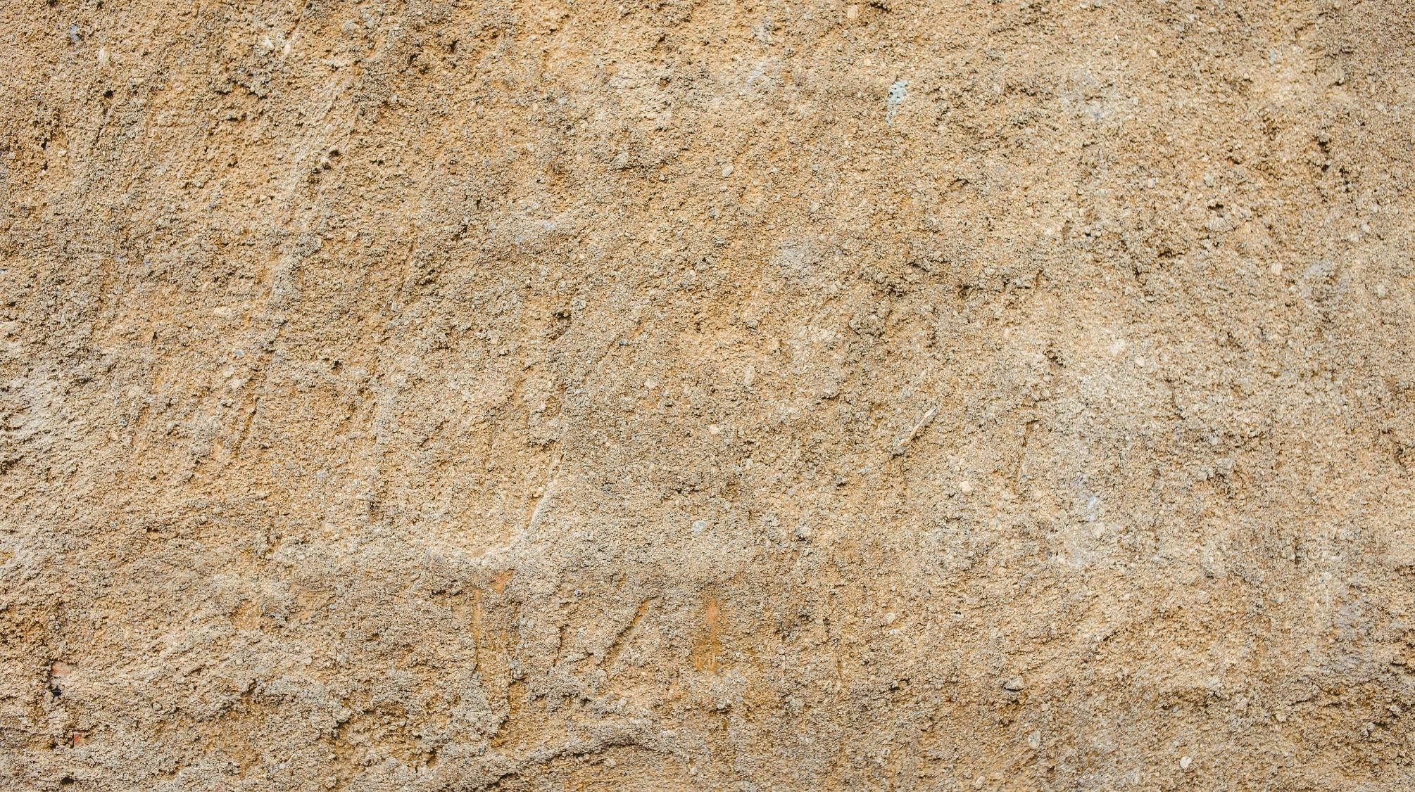
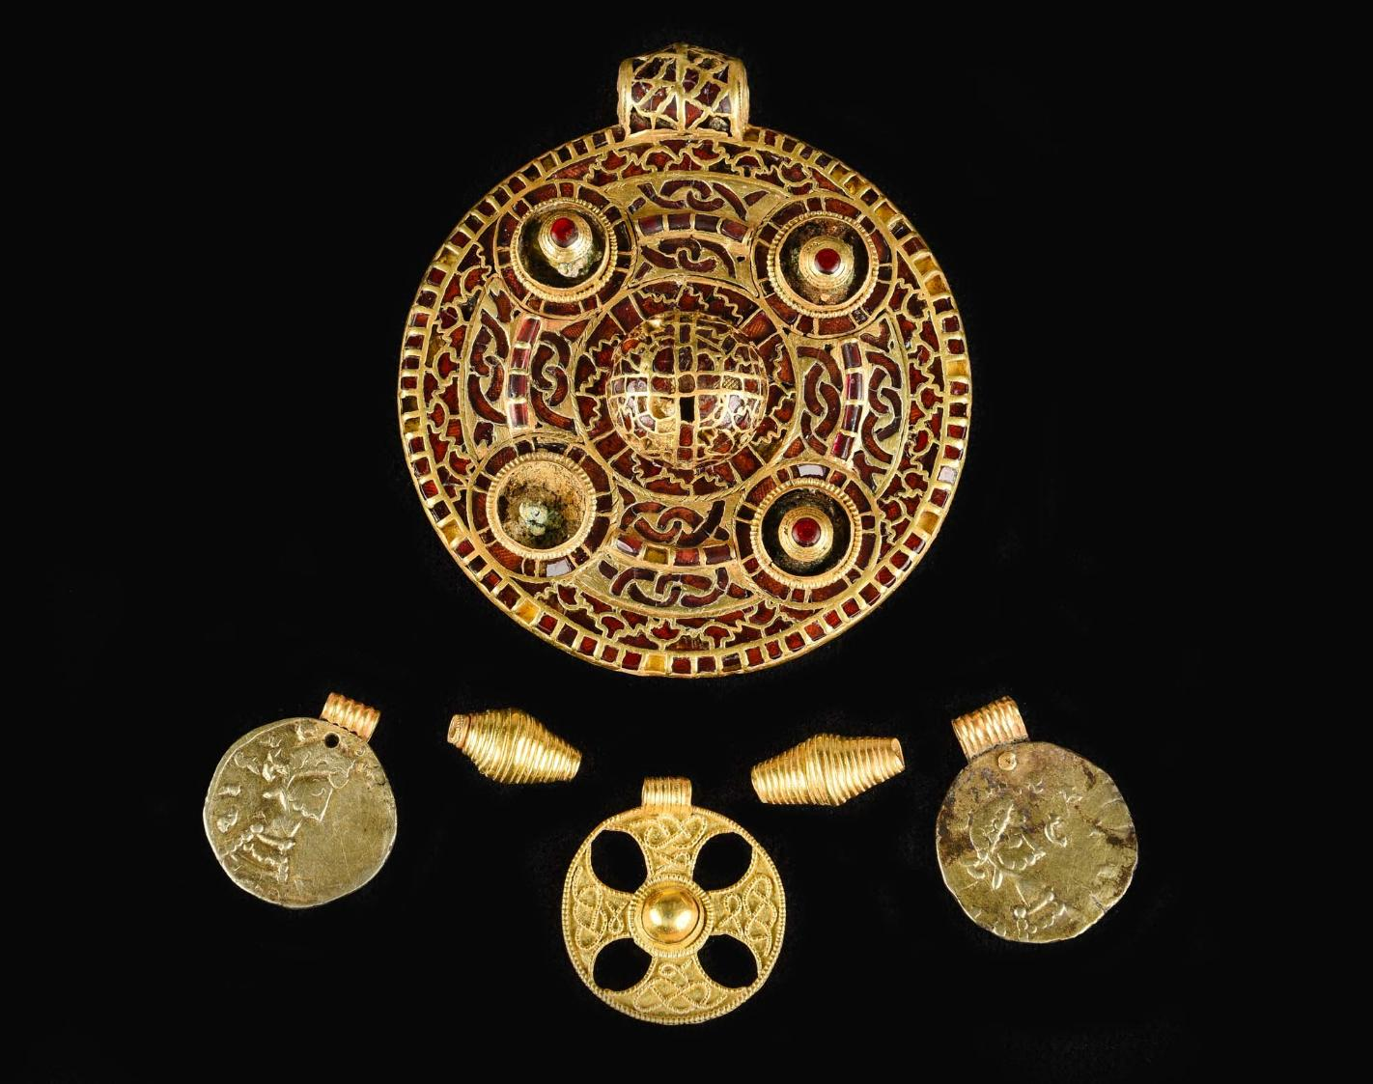

Beep
Beep
Beep!
Notes:
Image by Hsu Ting Chang from Pixabay
Metal detector sound from freesound.com

Slide 29


Dig
Dig
Dig
Notes:
Image by Hsu Ting Chang from Pixabay
Shovel icon created by Magnific on Flaticon
Digging with Shovel OWI.wav by Allen2001 -- https://freesound.org/s/595105/ -- License: Attribution 3.0

Slide 30
Brush
Brush
Brush
Notes:
Image by Hsu Ting Chang from Pixabay
Sweeping.wav by 200154michaela -- https://freesound.org/s/542442/ -- License: Attribution NonCommercial 3.0

Slide 31
What do you think this is?
How sure are you?
Notes:
Image by Hsu Ting Chang from Pixabay

Slide 32
0
1
2
3
4
5
cm
Notes:
Image by Hsu Ting Chang from Pixabay

Slide 33
0
1
2
3
4
5
cm
Notes:
Image by Hsu Ting Chang from Pixabay

Slide 34
0
1
2
3
4
5
cm
Notes:
Image by Hsu Ting Chang from Pixabay

Slide 35

0
1
2
3
4
5
cm
Notes:
Image by Hsu Ting Chang from Pixabay

Slide 36
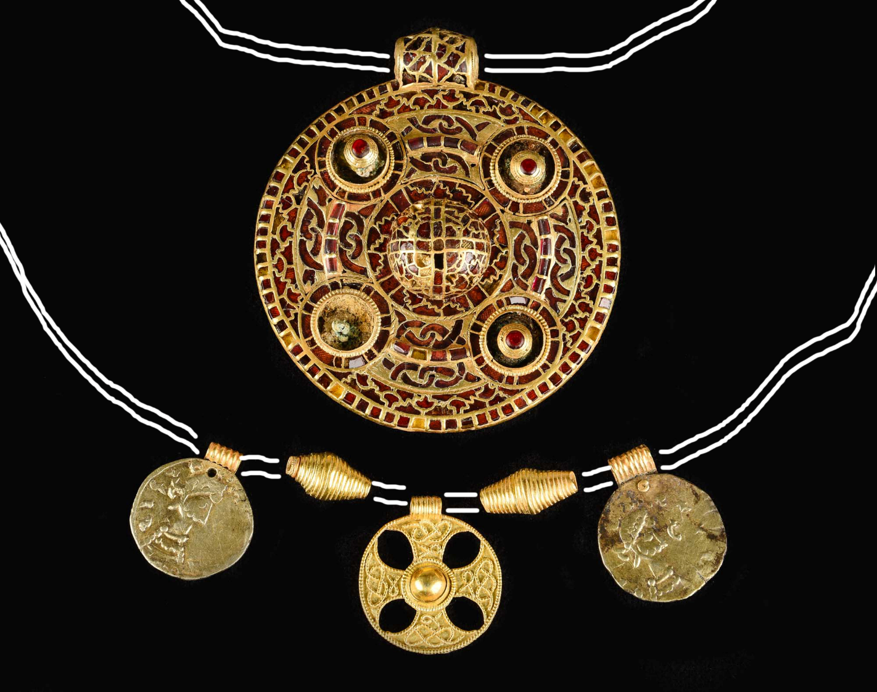
How the pendant and the necklace may have been worn.

Slide 37
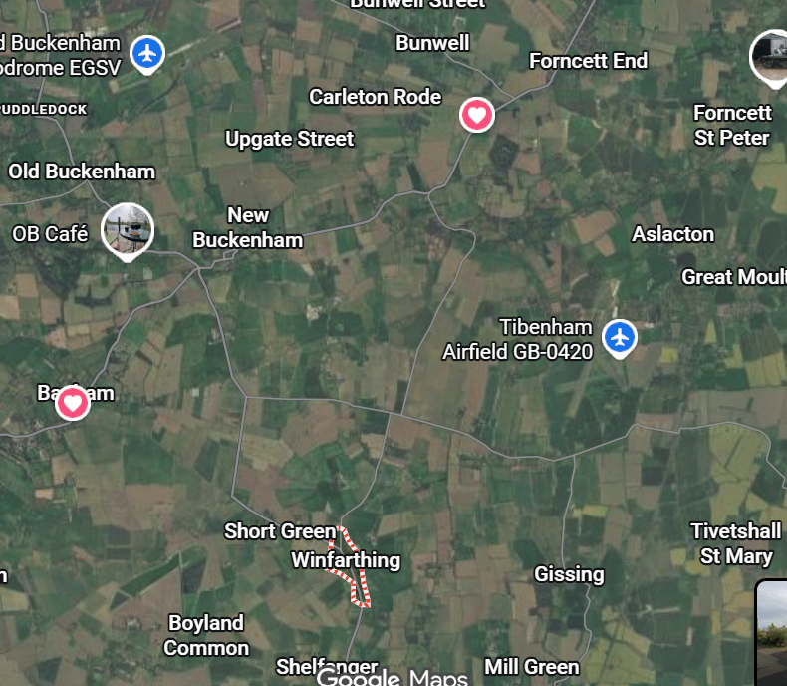
What is the story of this pendant?
Where was is it found?
The pendant was found in Winfarthing, a small village in South Norfolk, about 4 miles north of Diss, and 19 miles south of Norwich. Today it has a population of about 500 people.
Winfarthing appears in the Domesday Book of 1086 as ‘Wineferthinc’. The name means ‘Wina’s quarter part’ – land belonging to Wina.
The oldest building in the village is St Mary’s Church, parts of which date from the 13th century.
Until recently there was very little evidence of Anglo-Saxon settlement here.

Slide 38
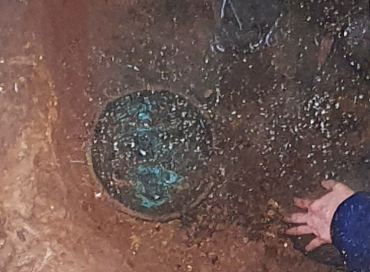
The story begins with an earlier discovery …
It was a cold winter’s day and an archaeology student from the University of East Anglia, Tom Lucking, was metal detecting in a field in the small village of Winfarthing. Suddenly he heard a loud sound come from his metal detector.
What was lay hidden beneath the earth? He carefully dug down into the cold soil. He was excited to see what he found.
The object was bigger than his hand and was different to the other items he had found in the fields around Winfarthing. This was special, he would need to be very careful and phone Norfolk County Council’s Portable Antiquities Scheme. He didn’t want to destroy the object, it looked very fragile.
DISCUSS: Look carefully at the picture, what do you think it was?

Slide 39
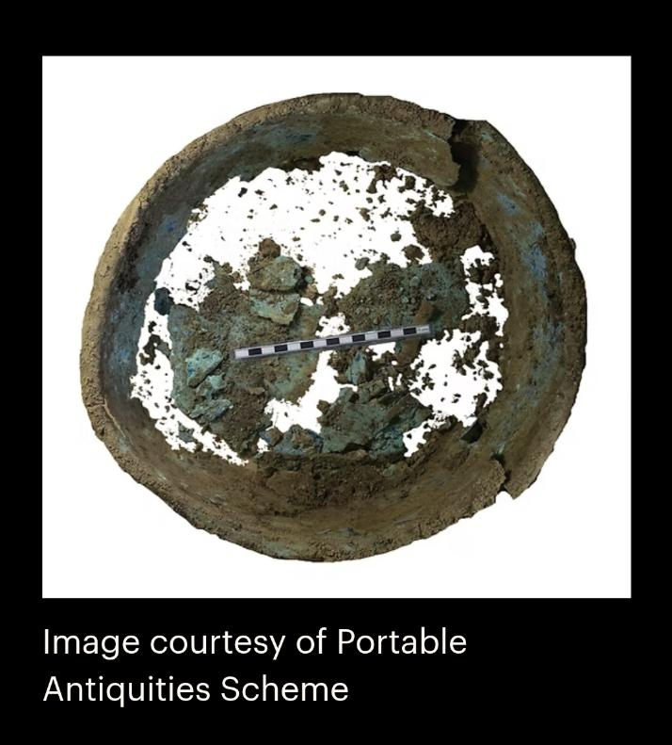
Do you want to change your hypothesis?
What do you think it is now?
How certain are you?
Tom thought the item could have been placed in or next to a grave.
He was right to call the Portable Antiquities Team. They carefully excavated the artefact and took a photograph of the find (see opposite).

Slide 40
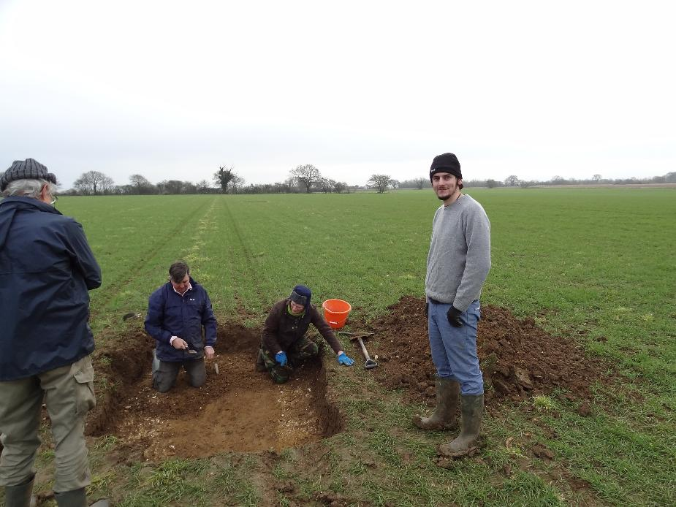
The excavation of the grave
Careful excavation by a team of archaeologists later revealed that the bowl was indeed part of the grave of an Anglo-Saxon woman.
It was when the team of archaeologists excavated the grave that they found the beautiful pendant that you have already seen.
Lots of other interesting artefacts were found in the grave. You will explore them later when you try and piece together the mystery of the Winfarthing lady.
Excavation of the grave of the Winfarthing lady, image courtesy of John Rainer

Slide 41

The excavation of the grave
Who was she?
Where did she come from?
How important was she in Anglo-Saxon times?
When was she buried?
How old was she when she died?
Why was she buried here?
Excavation of the grave of the Winfarthing lady, image courtesy of John Rainer

Slide 42
Activity: Sequencing the story of the pendant
Notes for teachers
Print the following slides – in their teams students should put them in order to see what has happened to the finds since they were discovered.

Slide 43
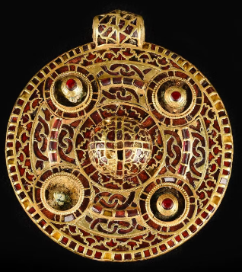
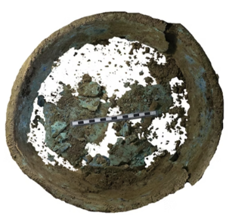
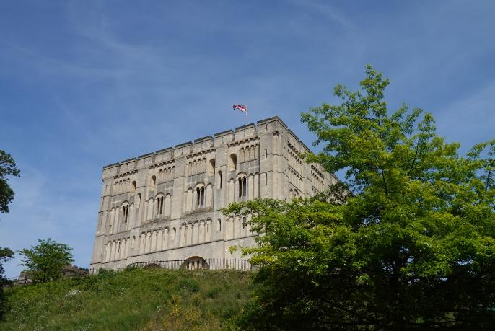
TEAM CHALLENGE: Can you sequence the story of the pendant?
At some point in the Anglo-Saxon period, the pendant and the bowl were buried in the grave of a lady from Winfarthing.
Around 1400 years later the bowl and pendant were discovered.
Today they are on display in a museum at the building in the photograph.
DISCUSS
Do you know where this is?
Can you place the 8 cards/slides in order to tell the story of how the pendant was found all the way through to it being a star attraction at the place in the photo?
Notes:
Object photos courtesy of Norfolk Museums Service
Photo of Norwich Castle by Hannah Salisbury

Slide 44
In 2014 a bowl is found by Tom Lucking, an archaeology student from UEA. Tom thinks that this bowl might be part of a grave burial.

Slide 45
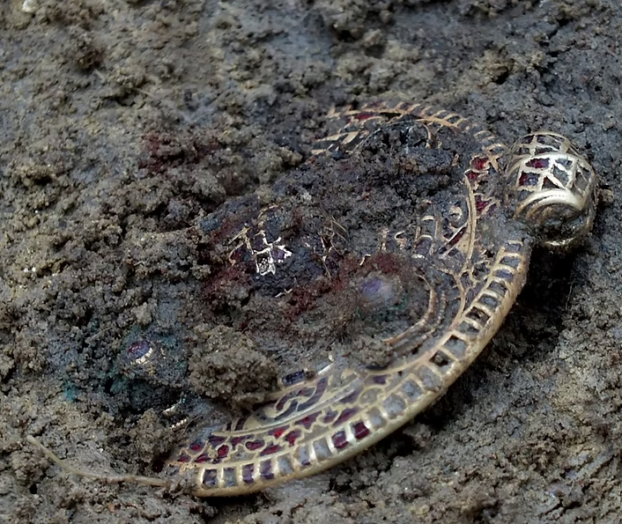
Norfolk County Council’s Portable Antiquities team carefully excavate the grave. They find the pendant and other grave goods.
Excavation of the grave of the Winfarthing lady, image courtesy of John Rainer
The pendant as it was discovered, image courtesy of Tom Lucking

Slide 46
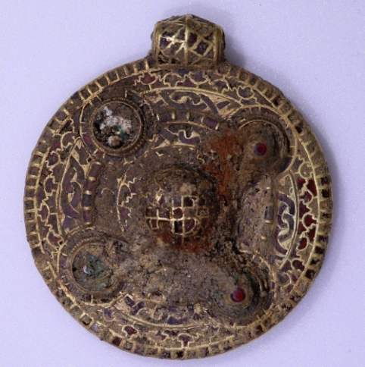
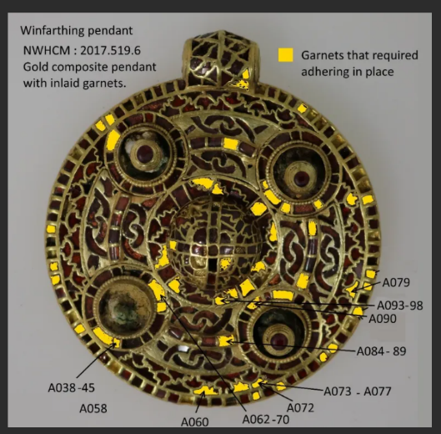
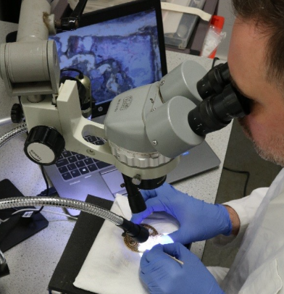
The artefacts are carefully cleaned and conserved by experts at Norwich museum.
The pendant was covered with hardened soil, sand and iron corrosion product.
The grave goods had not been cleaned or over handled before they came to the museum’s conservation experts.
This was important. The pendant could have broken into many pieces if it had been cleaned when it was first discovered. Many of the beautiful red garnets set within the gold could have been lost forever.
Many of the garnets, often measuring less than 1×1 mm, were only held in place by dry and sandy soil from which the pendant was excavated.
This was also the case for the central boss, which sat loosely on the surface of the pendant.
Loss of many of the garnets would surely have been the case if cleaning had been attempted immediately on discovery.
However, the careful handling of the pendant by the team that discovered it meant that the loose garnets could be stuck back into place.
The team had to work on the small pendant and even smaller garnets under powerful microscopes.
Images courtesy of Norfolk Museums Service
Notes:
Find out more about the conservation of the pendant here: https://nmasconservation.wordpress.com/2019/03/22/conservation-of-the-winfarthing-anglo-saxon-pendant/

Slide 47

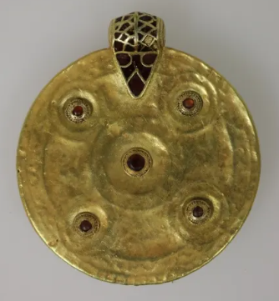
After lots of hard work, the pendant was fully restored to what it used to look like
The pendant is rare and was one of the finest of its type ever found in England.
The gold pendant is about 70 mm in diameter. Small gold cells were attached to a sheet of gold.
Then over 400 tiny red garnets were set into each cell. It is likely that the garnets came from Asia.
Even the back is inlaid with five garnets to cover rivets attaching the bosses on the front.
It is of similar quality and style to the finds at Sutton Hoo in Suffolk.
Images courtesy of Norfolk Museums Service

Slide 48
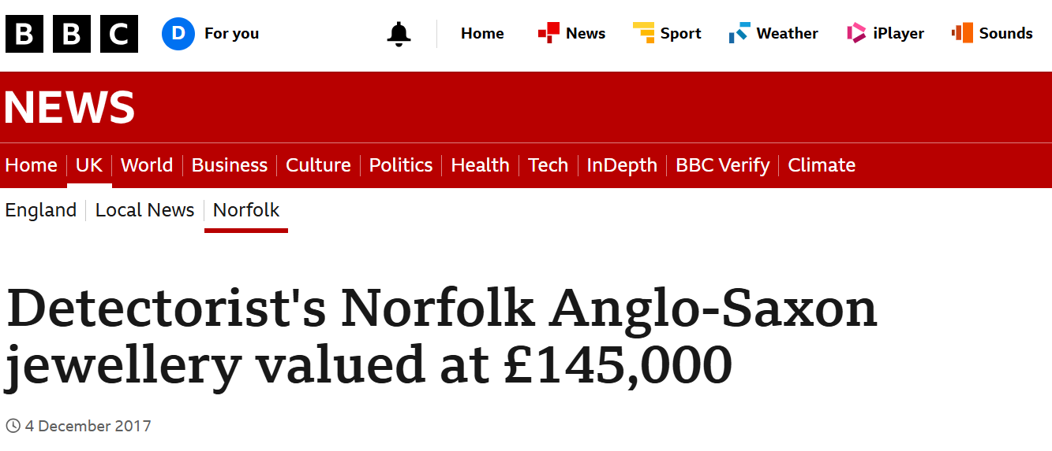
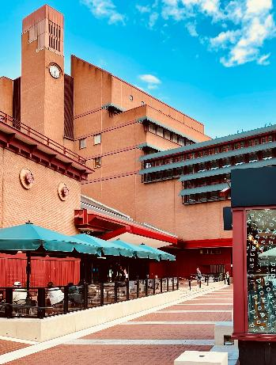

The treasures are sold for £145,000
Norwich Museums Service raised the money to buy the Winfarthing treasures.
The pendant was in demand, lots of people wanted to see it. Soon it was sent to an exhibition at a famous building in London.
DISCUSS - Look at the top picture. Do you know where? The bottom picture gives you a clue!
Notes:
Photo of British Library exterior by CrowN on Unsplash
Photo of British Library Reading Room by Tanya Barrow on Unsplash

Slide 49

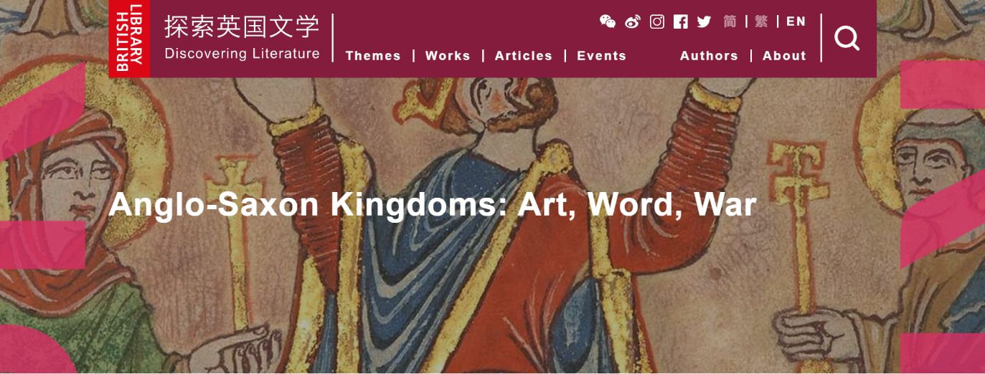
Star of the show in London!
In 2018 the British Library put on an exhibition called ‘Anglo Saxon Kingdoms: Art, Word, War’.
The pendant was one of 180 spectacular treasures on display.
The British Library is the national library of the United Kingdom and one of the largest research libraries in the world, holding an estimated collection of over 200 million items.
It receives a copy of every single book, newspaper, and pamphlet published across the UK and Ireland

Slide 50
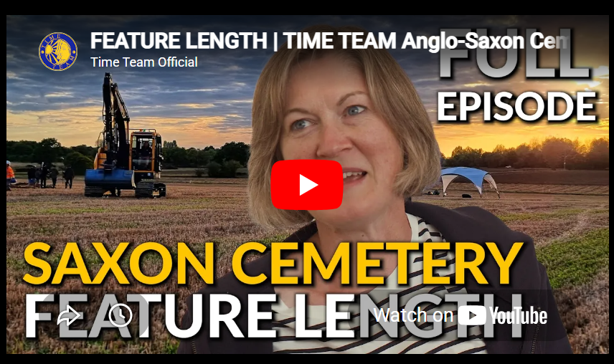
In 2022 TV Cameras arrived in Winfarthing!
They wanted to find out more about the Winfarthing lady who had been buried with the pendant on her chest.
When Time Team visited Winfarthing in 2022 they discovered other graves.
This indicated that the Winfarthing lady was not buried on her own but in a cemetery.
Time Team’s investigation helped to solve some of the mysteries surrounding the Winfarthing lady. But not all of their questions were answered.

Slide 51

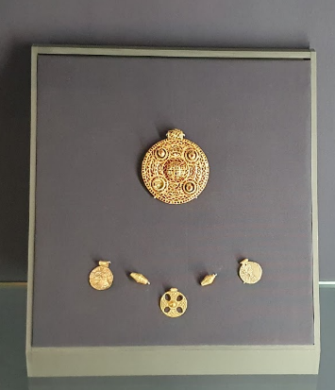
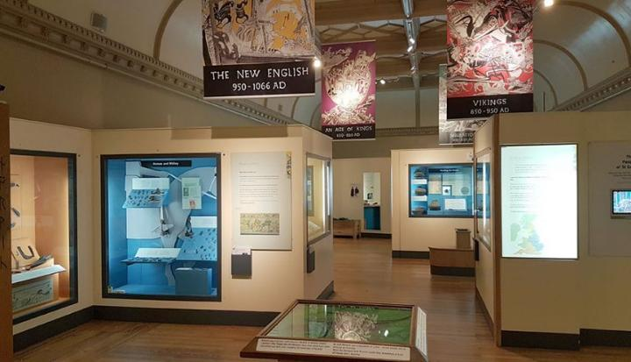
On display today in Norwich Castle
Thanks to grants from the National Heritage Memorial Fund, Art Fund and the Friends of the Norwich Museums, the Winfarthing Treasure is now displayed at Norwich Castle Museum.
The Winfarthing pendant is currently on display in the Anglo-Saxons and Vikings gallery at Norwich Castle Museum and Art Gallery.
Notes:
Photos by Hannah Salisbury and Dale Banham

Slide 52
PART 4: What do the clues found by Time Team reveal about the person who was buried in the grave and why she was buried there?
Notes for teachers
Part 4 of the enquiry involves pupils working in groups using 6 clue cards to try and find the answers to 10 important questions about the Winfarthing lady, whom the pendant and other grave goods belonged to.
Teachers need to print out the following slides as clue cards. There are 6 double sided clue cards.
Teachers can also play sections of the Time Team documentary to supplement the information on the clue cards. Useful short sections from Time Team are suggested in red on the clue cards.
Slide 66 can be printed out as a worksheet for the pupils to fill in.
The worksheet encourages pupils to think about how sure they are about the claims they are making. As pupils state their hypothesis get them to out of their seats and stand on the DEGREE OF CERTAINTY LINE (see below) to reflect their position.
The activity on Slide 50 reinforces the concept of the degree of certainty line and consolidates the knowledge that has been learn during part 4 of the enquiry.

Slide 53
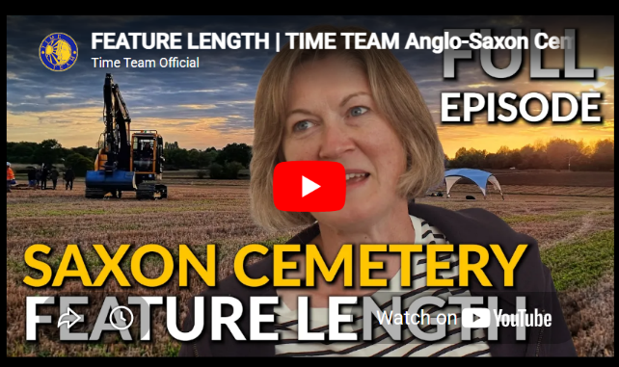
To print
TIME TEAM CHALLENGE: Can you use the clues that Time Team uncovered to solve the mystery of the Winfarthing lady? 10 puzzles remain …
Who was she?
Where was she born?
Where did the goods in her grave come from?
What religion was she?
What was her role in Anglo-Saxon society?
How important was she? Was she of high status?
How old was she when she died?
When did she die?
Why was she buried at Winfarthing?
Why was her discovery so important to archaeologists and historians today?

Slide 54

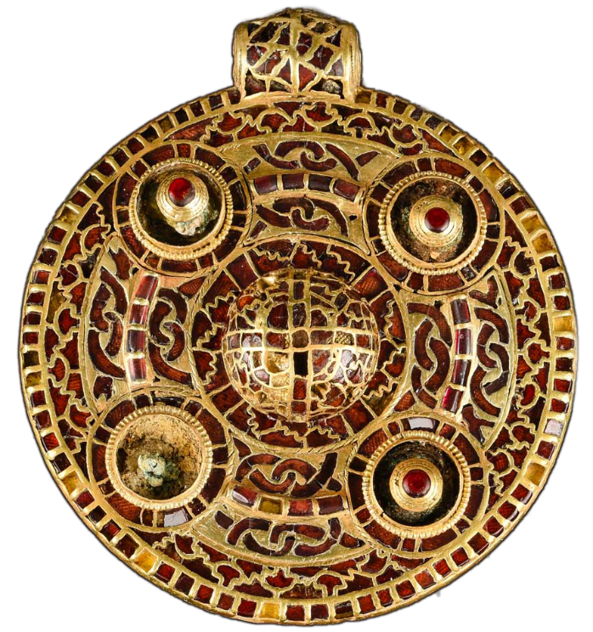
CLUE 1
To print
This would have been an unbelievably expensive item.
Remember the red garnets may have come from Asia.
EXTRA CLUES … SEE VIDEO CLIP FROM TIME TEAM – A 3D model of the pendant (c14 mins in)
DISCUSS: What do the images of animals and serpents tell us?

Slide 55
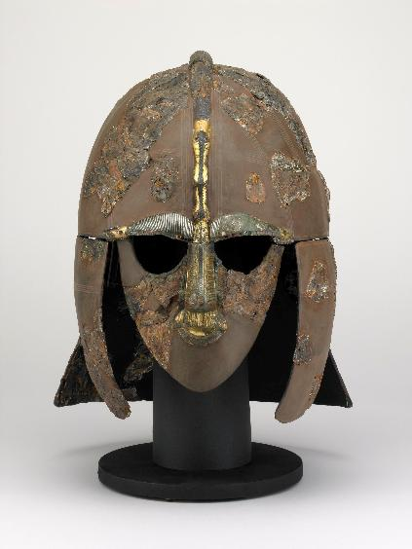
Was the Winfarthing lady related to royalty?
To print
The woman was buried with exceptional jewellery, indicating that she must have been of a very high social status, possibly even royalty.
Could she have been part of the East Anglian royal family?
The gold may have been produced in Britain, but the garnets were probably from Asia (India or Sri Lanka).
Might the Winfarthing lady be somehow connected to Raedwald , a king of East Anglia, who died 624. He might be the King buried at Sutton Hoo. and he had converted to Christianity (from Paganism).
Notes:
Sutton Hoo helmet image © The Trustees of the British Museum. Shared under a Creative Commons Attribution-NonCommercial-ShareAlike 4.0 International (CC BY-NC-SA 4.0) licence.

Slide 56
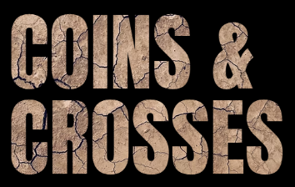
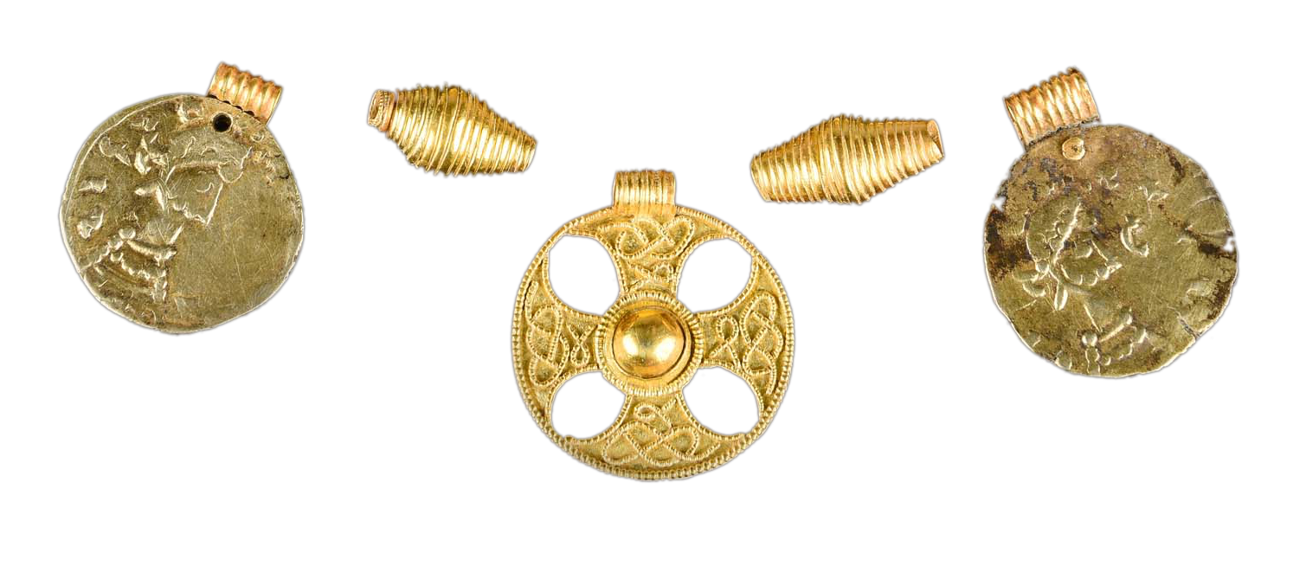
CLUE 2: Other grave goods … included a necklace made up of two gold beads, two pendants made from identical coins and a gold cross pendant.
DISCUSS: What might the cross indicate?
To print

Slide 57
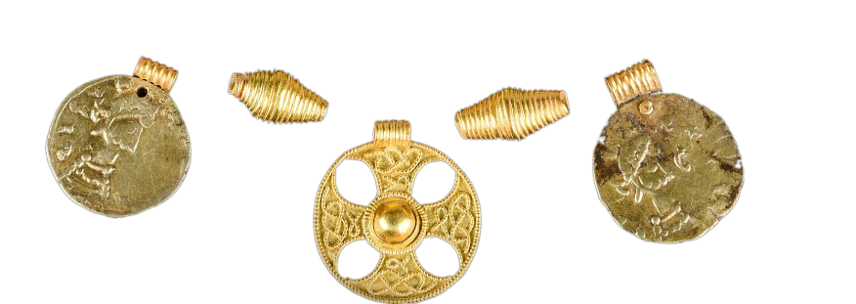
Other grave goods
To print
The other jewellery found was:
2 coiled wire beads
2 pendants made from coins of King Siegbert III who ruled the Frankish Empire (this covered parts of what are today France and Germany). This tells us that there was some kind of connection between the woman in this grave in Winfarthing and Europe
The grave also contained everyday objects:
an iron knife
a pottery vessel (made in France)
a collection of copper alloy rings. These would have been worn around the waist and used to carry small items like keys.

Slide 58

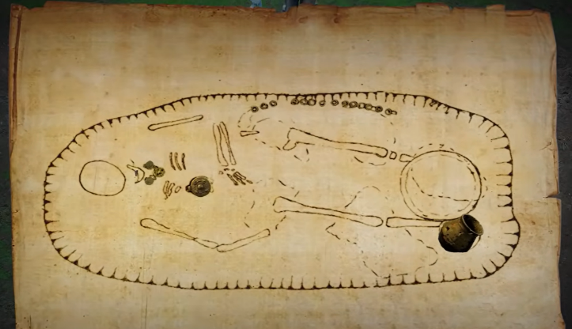
CLUE 3
To print
Bones do not often survive in East Anglia’s acidic soils. This grave is a rare exception, as a partial skeleton remained.
Time Team archaeologists concluded that she was quite a small woman, over 40 years old and possibly over 50.
She had a good diet as a child and as an adult.
She spent her childhood in continental Europe, possibly in the Rhineland (Germany).
Diagram of the surviving bones and grave goods found at Winfarthing by Time Team

Slide 59

How did Time Team reach their conclusions?
To print
EXTRA CLUES – SEE TIME TEAM VIDEO - Analysis of bones held at castle (c18 mins in)
The pelvis was that of a woman
The chin was smaller than that of a man
The skull was fully fused – therefore she was not young
The teeth were very worn (almost flat)
Changes in spine – therefore over 40, potentially over 50
Using isotope analysis of the teeth they could determines if she grew up locally or abroad
Her teeth also suggest she had a good diet
Map showing location of the Rhineland, where the Winfarthing lady may have grown up

Slide 60


CLUE 4
To print
The bronze bowl was the first item that Tom found. It was carefully studied by experts from Time Team. They found out that it was not empty when it was buried..
At the time of her burial this bowl was filled with plants – foxgloves, horsetail, blushing lanterns, bracken, pear or apple stems, and birch tree bark.
These all flower in early summer, indicating the time of her burial.
But many of these plants were not used for decoration. TURN OVER to find out why they were special and some important clues about our mystery lady’s role in Anglo-Saxon society.

Slide 61




To print
Foxglove was used to treat boils, headaches, paralysis, stomach ulcers, open wounds and epilepsy. However, overdosing could result in vomiting, diarrhoea or even death.
Birch bark was used to ease muscle pain and soothe skin complaints.
Horsetail was used to stop bleeding, heal ulcers and wounds, and kidney problems. This plant contains silicon, which helps strengthen bone.
Bracken leaves were eaten to purge the stomach and relieve problems in the spleen and intestines, including broad worms.
Notes:
Foxglove photo by Annie Spratt on Unsplash
Horsetail photo by Andreas Brunn on Unsplash
Bracken photo by Hannah Salisbury
Birch tree photo by Peng Chen on Unsplash

Slide 62

CLUE 5: Evidence from the cemetery and the next field
To print
Time Team found other graves near to where the Winfarthing lady was buried.
Grave goods have been scattered across the field by ploughing.
EXTRA CLUES … SEE VIDEO CLIP FROM TIME TEAM c 22 mins in
However, her grave survived better than others because she was buried deeper or may have been covered by a mound.
The cemetery was possibly in use for centuries. The landscape surrounding the cemetery forms a natural amphitheatre and could have been an important meeting place in Roman times.
Time Team also found evidence of a possible Roman shrine at a nearby spring, suggesting this had been an important place for generations.​
THINK …
Why was she buried deeper than other graves?
Why was she buried apart from other bodies?

Slide 63

Meanwhile in the next field Time Team found evidence that the site was used by the Romans
To print
How did Time Team know the Romans were at Winfarthing?
Building materials – ceramic roof tiles, wall foundations
A Roman hypocaust to heat water
Roman brooches, tweezers, ear scoops, finger rings, bracelets, part of a sword belt (suggesting the Roman army could have passed through)
Coins from late 3rd century through to 402 AD
Perhaps these were offered to the gods and Winfarthing was also site of a Roman shrine.
Anglo-Saxon cemeteries were often based where Roman shrines had been located.
Roman brooch found in Winfarthing
Notes:
Brown, A. (2013) SF-F28AD1: Roman brooch. Web page available at https://finds.org.uk/pas/recorded-find/SF-F28AD1 under a CC-BY licence [Accessed: 10 Aug 2026 11:25:10]

Slide 64

CLUE 6: Evidence from the wider region
To print
Similar Anglo-Saxon finds have been made at Sutton Hoo, Rendlesham, in Caistor St Edmund (near Norwich), and at Boss Hall (near Ipswich).
High status Anglo-Saxon graves are usually found in important settlements.
The remarkably rich objects contained in graves across Norfolk and Suffolk show that there must have been a few exceptionally wealthy families in the area South of Norwich.
They could buy expensive goods like jewellery with the money that they made.

Slide 65


How do we know Winfarthing was important?
To print
Today, Winfarthing is a small village but it may have been an important place in Anglo-Saxon times.
The clue is in the place name – ‘Wina’s quarter part’ – land belonging to Wina. It was therefore part of broader area that included three other hundreds: Earsham, Hoxne and Hartismere.
Areas of Anglo-Saxon England were divided into ‘hundreds’ – made up of 100 farms or houses. Winfarthing was the centre.
Diss took over from Winfarthing as the centre for a hundred at a later date. But at the time we are studying, Winfarthing was a centre of influence for a large area and an important part of East Anglia.
Notes:
Norfolk Hundreds map, based on 1. https://mapper.acme.com/; and 2. https://commons.wikimedia.org/wiki/File:Norfolk_Hundreds.svg
Map of Anglo-Saxon kingdoms, Encyclopædia Britannica, Inc. https://www.britannica.com/topic/Heptarchy#/media/1/262375/54563 Access Date 10 August 2026

Slide 66


To print

Slide 67
Conclusions: What did she look like? How was she buried?
How certain are we?
1. She lived a long life
2. She was very important and of high status
3. She was related to royalty ( the Kings & Queens of East Anglia)
4. She was a Christian
5. She was a healer who cared for people who were ill
6. There was music, feasting, stories and poetry and her funeral
7. She was buried in a special place that had been significant for centuries (as a shrine and centre of government)
TASK: Use the two video clips below and your own research notes to discuss how sure you are about the claims opposite.
For a reconstruction of what she may have looked like - SEE VIDEO CLIP FROM TIME TEAM (c1hr 40 mins in)
For a reconstruction of the funeral ceremony - SEE VIDEO CLIP FROM TIME TEAM (c1hr 50 mins in)

Slide 68
PART 5: What was life like in a typical Anglo-Saxon village?
Notes for teachers
Part 5 of the enquiry involves pupils working in teams to research the key features of a typical Anglo-Saxon village. Each member of the team should research one or more of the following areas:
Power – Who controlled the local area? Who was in charge?
Economics – What types of trade were there? What did people make? What types of job were there? What did they buy and sell?
Religion – What did people believe? How did they worship?
Military – Who fought in the army? How was it paid for?
Society – What did people eat and drink? What did people do in their free time for entertainment? What were homes like? How did people communicate?
The next slide provides a task sheet for the pupils, and the following slides can be printed off as information sheets.
This enquiry ends with a quick multiple-choice quiz about Anglo-Saxon language.

Slide 69

To print
What was life like in a typical Anglo-Saxon village?
TASK – COLLECTIVE MEMORY
Split your term into expert historians.
Use the reconstruction (picture) and information sheets.
One person becomes an expert on each of these key areas:
Power – Who was in charge?
Economics – What types of job were there? What did they buy and sell?
Religion – What did people believe?
Military – Who fought in the army?
Society – What did people eat and drink? What did people do in their free time for entertainment? What were homes likes?

Slide 70


What could Winfarthing have looked like towards the end of the Anglo-Saxon period?
To print
Hodder Education
Notes:
Anglo-Saxon village illustration from Anglo-Saxon and Norman England c1060-88
Authors: Ian Dawson, Esther Arnott, Libby Merritt
Editors: Dale Banham & Ian Dawson
Hodder Education 2016

Slide 71

To print
EXTRA INFORMATION: RELIGION
Archaeologists recognise the graves of Anglo-Saxons by the different way they buried their dead. In the early Anglo-Saxon period, most people were buried with some of their everyday possessions.
This suggests that people believed in some form of life after death. These objects were called grave goods.
The early Anglo Saxons had a variety of gods and beliefs, different to those of the Romans before them. The gods seem to have been worshipped outside at holy sites like clearings in woods or on hillsides.
Christianity became a popular new religion and was introduced to Anglo-Saxon England in 597 AD.
However old habits died hard and it took about 100 years before Christianity became widespread.
As Christianity became established people were buried without objects, in churchyards.
Archaeologists are able to show, through objects on the sites they excavate how society was changing. But it cannot provide all the answers to questions about when people stopped believing in Pagan gods.
Did you know?
Today our names for the days of the week still recall four of these Anglo-Saxon gods: tiw (Tuesday), Woden (Wednesday), Thunor, (Thursday), and the goddess frig (Friday).

Slide 72

What have we learnt about … Food and diet?
To print
EXTRA INFORMATION: FOOD & DRINK
Archaeologists can tell what people ate in the past by looking at the rubbish they threw away.
Animal bones show that cattle, pigs, sheep and poultry (chicken) with the most common types of meat eaten.
Seeds and grains show that the main crops were wheat and barley, which were used for making bread and the malt needed to brew beer.
A wide range of fish were caught and included some species we would not eat today. Eels, pike and trout were caught in rivers while the sea provided herring, salmon, and shellfish.
The problems of not always having a stable diet or enough food to eat can be seen in the bones of the dead. Several bodies excavated show evidence of rickets. This is a disease caused by lack of vitamin D, which causes the bones of arms and legs to bend.

Slide 73

To print
EXTRA INFORMATION: FEASTING & ENTERTAINMENT
Life in Anglo-Saxon England was hard for most people. Feasting was an important chance for leaders to reward their people and bring them together as a community.
Such events could be crucial in times of war when the Lord needed the support all fighting men.
Lyres (see opposite) were stringed musical instruments similar to harps.
Archaeological finds show they were sophisticated and must have been specially made by skilled craftsmen.
Lyres and other musical instruments have been found in East Anglia. Archaeologists have been able to use tiny fragments to reconstruct the original musical instruments.
A modern recreation of an Anglo-Saxon lyre
Notes:
Photo by Hannah Salisbury

Slide 74

To print
EXTRA INFORMATION: LANGUAGE & COMMUNICATION
Immigration is nothing new. When the Roman Empire crumbled in the early 5th century, families and entire tribes set out across Europe in search of a better life. With them, they took their languages, gods and different ways of life.
The Anglo-Saxon, Germanic peoples emigrated to Britain. A new culture emerged.
It gave England its present name, the language we still speak today, Kings and Queens and the names of many places where we live.
EXTRA CHALLENGE:
Your team has 2 minutes to learn the meanings of 8 Anglo-Saxon words of phrases.
How many can you remember in the test that follows?

Slide 75
snoflig
A
Sickness, illness, disease
B
Full of snivel, having a cold in the head
C
Whole, hale, sound, in good health

Slide 76
hál
A
Sickness, illness, disease
B
Full of snivel, having a cold in the head
C
Whole, hale, sound, in good health

Slide 77
seócness
A
Sickness, illness, disease
B
Doctor or physician
C
A lung disease

Slide 78
heorte ace
A
Heart pain
B
Full of snivel, having a cold in the head
C
A lung disease

Slide 79
lǽce/Leech
A
A disease of the foot (gout)
B
Full of snivel, having a cold in the head
C
Doctor or physician

Slide 80
adl
A
A disease of the foot (gout)
B
A general term for disease or sickness
C
In good health

Slide 81
fotadl
A
A disease of the foot (gout)
B
A lung disease
C
In good health

Slide 82
lungenadl
A
Heart pain
B
A lung disease
C
In good health

Slide 83
PART 6: What have you learnt about the Anglo-Saxons?
Notes for teachers
Part 6 provides an opportunity for pupils to reflect on everything they have learnt during the first 5 parts of this enquiry.
This includes reflecting on how their disciplinary knowledge as developed (not just their substantive knowledge).
Pupils also return to the word wall they discussed in PART 2 of the enquiry. It should be interesting to discuss how their views of the Anglo-Saxons have changed as a result of this enquiry and which key pieces of evidence led to their interpretation changing.
Part 6 also provides an extra challenge – pupils have to try and defeat 5 common ‘popular’ myths about the Anglo-Saxons using their knowledge and understanding of the period.

Slide 84
PART 6: REFELCT
What have you learnt about the Anglo-Saxons?
DISCUSS
1. What surprised you about this enquiry?
2. What have you learnt about the way that historians and archaeologists work? How do they find out about the past? Are they always certain?
3. What 3 words would you use to describe the Anglo-Saxons now?
EXTRA CHALLENGE – Destroying myths about the Anglo-Saxons
There are a lot of myths that exist about the Anglo-Saxon period (see myths A-E on the next side). How many of these myths can you destroy with the evidence you have collected during this enquiry? The more evidence you have the stronger your argument (or counter claim) becomes!

Slide 85


Slide 86
Useful resources
Notes for teachers
Portably Antiquities Scheme Finds Database: https://finds.org.uk/
Cotswold Archaeology online museum: https://cotswoldarchaeology.co.uk/museum/

Slide 87



The production of this resource has been funded by The National Lottery Heritage Fund as part of Coins and Crosses: Seeking the Anglo-Saxons in Winfarthing and Waveney.
Find out more and keep up to date on our Facebook page, website, or email list:
https://www.winfarthing-anglosaxon.org/
Winfarthing Anglo-Saxon Project
Join our mailing list through our website or by emailing wasp650ad@gmail.com

